Slide 1
Control System Design by Simulation using Simulink
Introduction of Simulink
Bioprocess Controller Design
Case study

Slide 2
Simulink
Used to model, analyze and simulate dynamic systems using block diagrams.
Fully integrated with MATLAB , easy and fast to learn and flexible.
It has comprehensive block library which can be used to simulate linear, non–linear or discrete systems – excellent research tools.
Provides a graphical user interface for constructing block diagram of a system
C codes can be generated from Simulink models for embedded applications and rapid prototyping of control systems.

Slide 3
Simulink Elements
Inputs
Block transfer functions
Outputs
Connection
Display

Slide 4
Simulink Library
Inputs
Source: Step, Rump, Sin wave, etc.
Block transfer functions
Commonly Used Blocks, Math Operations
Connection and labeling
Following block diagram flow
Outputs
Results
Display
Sinks: Scope, xy graph

Slide 5
Simulink Modelling
Start Simulink by clicking Simulink Icon

Slide 6
Simulink Modelling
Start Simulink by typing simulink at Matlab prompt
Simulink library and untitled windows appear
It is where we obtain the blocks to construct our model
This is here where we construct our model.

Slide 7
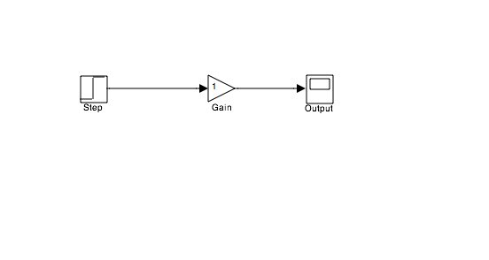
Simulink Modelling
r
c
Kp
‘Drag and drop’ block from the Simulink library window to the untitled window

Slide 8
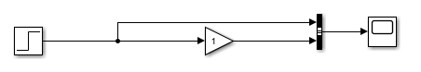
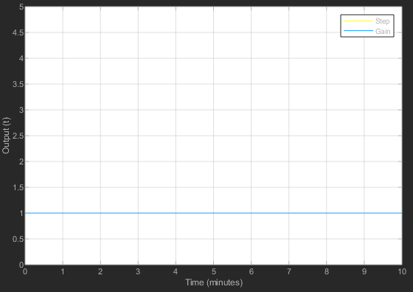
Simulink Modelling
Input
Kp
Output
r(t)=u(t), tstep = 0, r(0)=0, Gain=1
where tstep is the delay time.

Slide 9
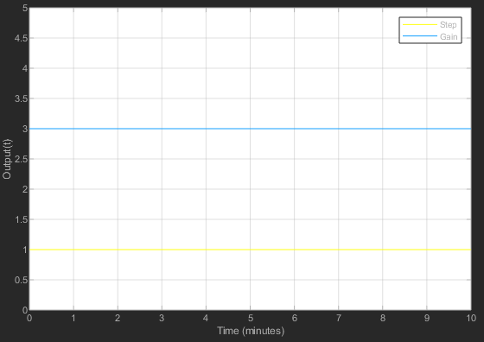
Simulink Modelling
Input
Kp
Output
r(t)=u(t), tstep = 0, r(0)=0, Gain=3

Slide 10
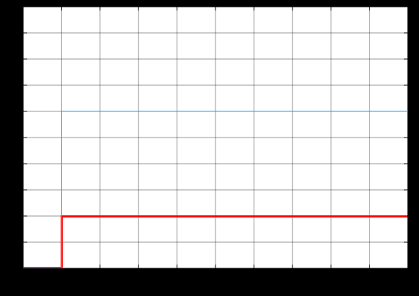
Simulink Modelling
Input
Kp
Output
r(t)=10u(t-1), tstep = 1, r(0)=2, Gain=3

Slide 11
General Control Loop Structure
z
r
e
y
c
Controller
Process
-
r: input c: control variable
e: control error z: disturbance
y: actuating variable
10

Slide 12
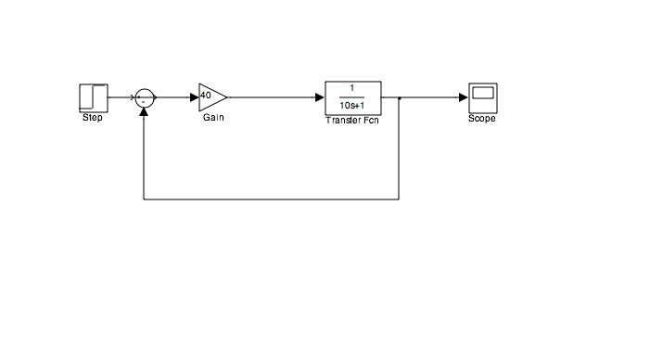
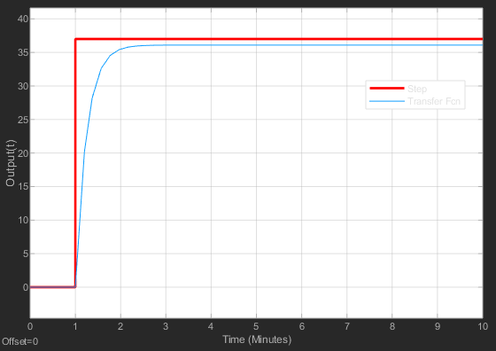
Simulink Model of P Control System

Slide 13
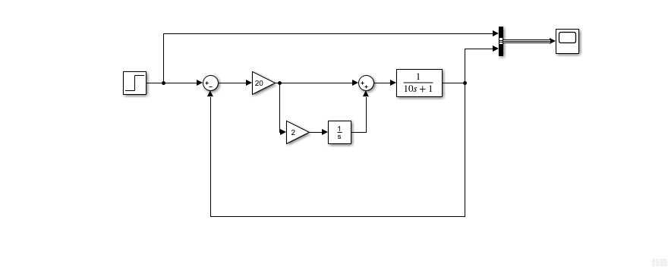
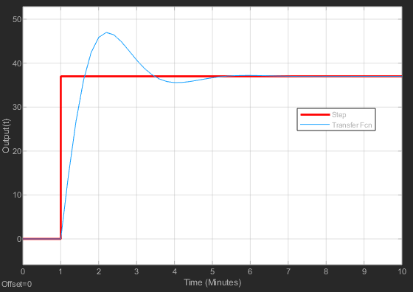
Simulink Model of PI Control System

Slide 14
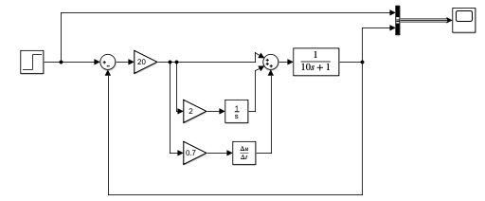
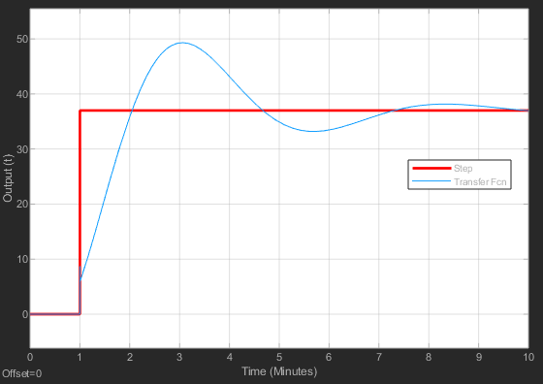
Simulink Model of PID
Control System

Slide 15
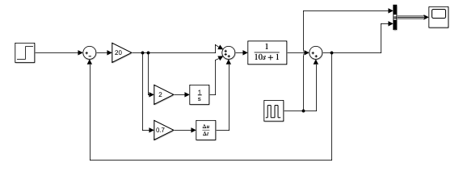
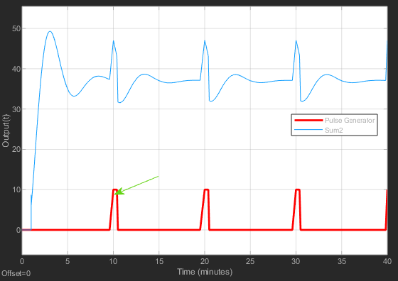
Simulink Model of PID Control
System with Disturbance
Disturbance

Slide 16
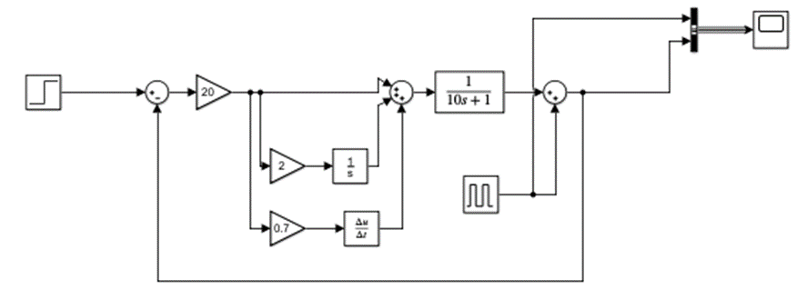
Simulink Model of
PID Control System
Other disturbance
Exponential disturbance?

Slide 17
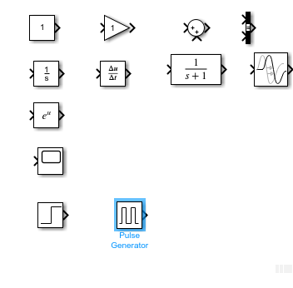
Useful Blocks in Simulink
Commonly Used Blocks
Continuous
Math operation
Sinks
Sources

Slide 18
Bioprocess Controller Design
Specify criteria
Determine process models
Develop Simulink Model
Specify PID parameters

Slide 19
Bioprocess Controller Design
Specify criteria:
Overshoot allowed
Fast response specified in term of settling time
Robust- wide range of operating conditions
Minimize movement – avoid large, expensive, or sensitive actuators

Slide 20
PID Tuning Methods
Closed loop Ziegler-Nichols method
(Ultimate gain tuning method)
Criteria: ¼ decay ratio
Doesn’t require the process model
Use the real system to tune the parameters
Time consuming
It is not suitable for first order or second order system without dead time

Slide 21
PID Tuning Methods
Obtain a unit step response of the plant experimentally and it may look ’s’ shaped curve as shown in figure below. This method applies, if obtained response exhibit s-shaped curve for unit step input otherwise it cannot be applied. This curve can also be obtained by dynamic simulation of the plant.
Obtain two constants, delay time L and time constant T by drawing a tangent line at the inflection point of the s-shaped curve.
Set the parameters of Kp, Ti, and Td values from the table given below for three types of controllers.

Slide 22
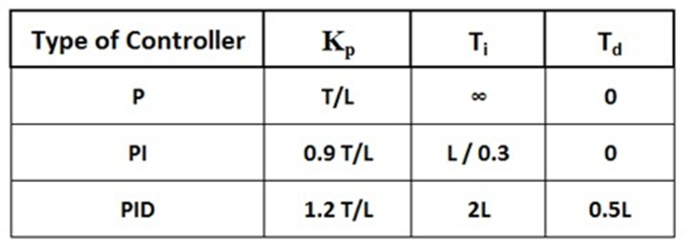
PID Tuning Methods
Process
L
T

Slide 23
PID Tuning Methods
It is very similar to the trial and error method where integral and derivative terms are set to the zero, i.e., making Ti infinity and Td zero.
Increase the proportional gain such that the output exhibits sustained oscillations. If the system does not produce sustained oscillations then this method cannot be applied. The gain at which sustained oscillations produced is called as critical gain, Kcr.
Once the sustain oscillations are produced, set the values of Ti and Td as per the given table for P, PI and PID controllers based on critical gain and critical period.

Slide 24
PID Tuning Methods

Slide 25
PID Tuning Methods

